Slide 1
Website Building
Weebly for Education
By Lisa Wensmann

Slide 2
AGENDA
Free sites for website building
Features of Weebly
Build a Classroom website
Set up student accounts.
Work Time

Slide 3
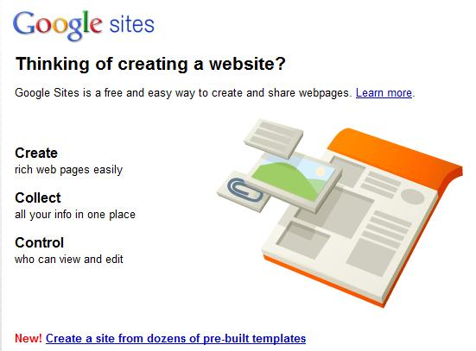
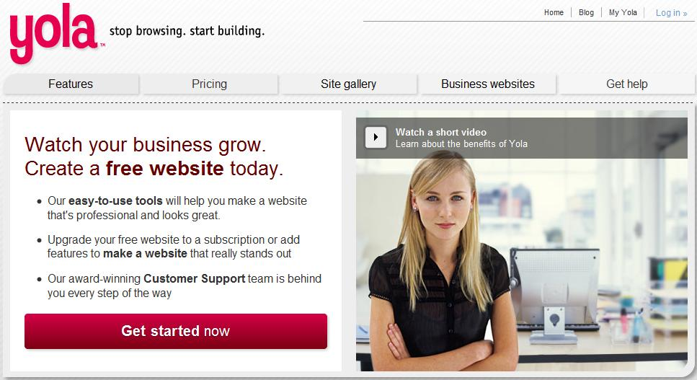
Free Web-authoring Sites
Google Sites: Not as many options as Weebly
Yola: Geared towards business websites.

Slide 4
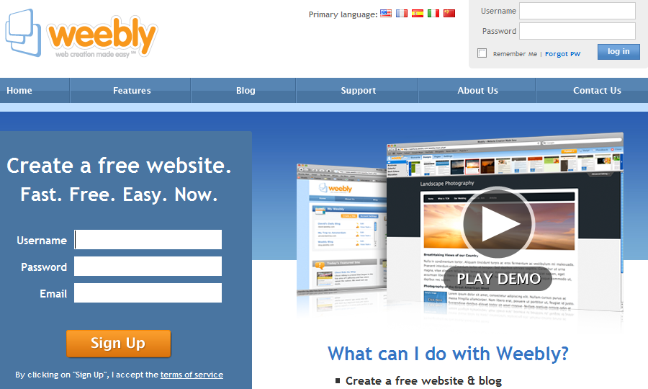
WEEBLY
Has functions specifically for use in education and the classroom

Slide 5
Features:
Build a class website
Create a classroom blog.
Allow students to build password protected web pages and blogs
Subscribe to create a custom domain and access more features.

Slide 6
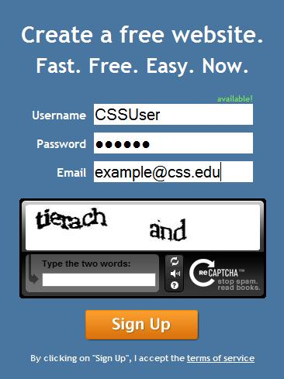
Sign up
Go to www.weebly.com
Sign up for free.
Insert Username of your choice.
Create a password at least 4 characters long
Enter your
email address
Enter the words
you see.

Slide 7
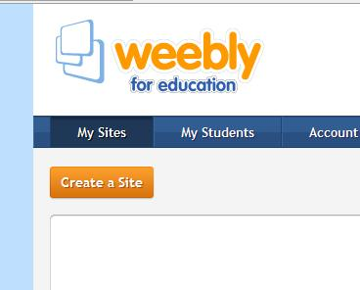
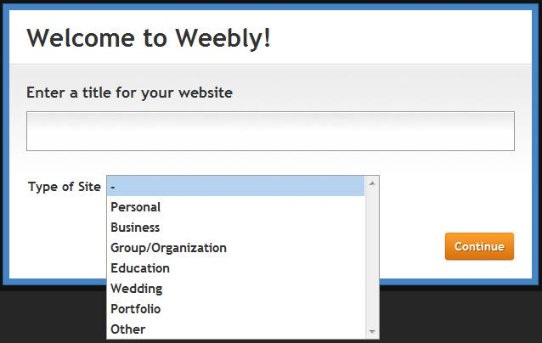
Creating a Website
Choose a title
Choose
“Education”
Click Here

Slide 8
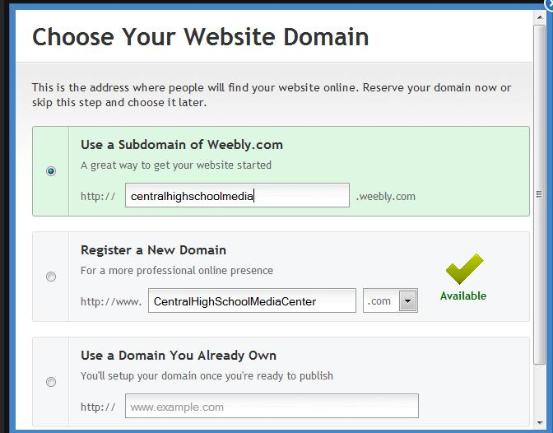
Creating the site
Choose unless you plan on purchasing a subscription
~

Slide 9
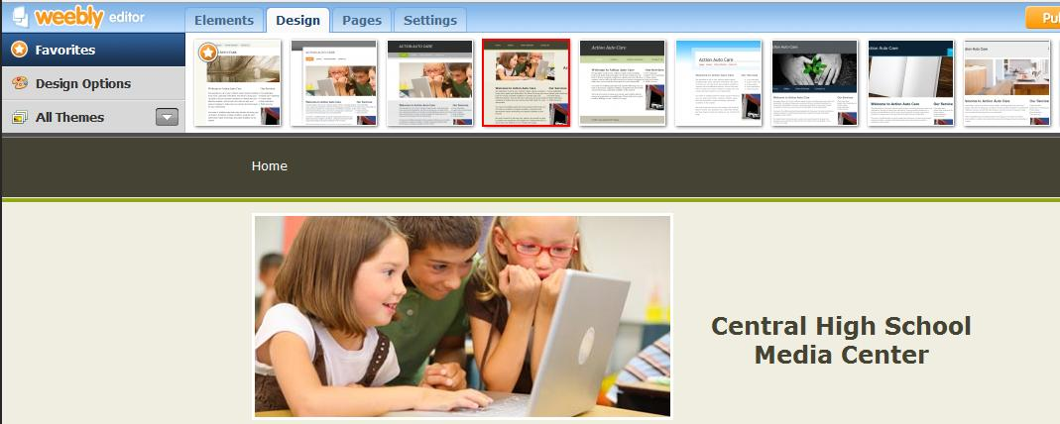
Design
Choose a template
Edit text styles.

Slide 10
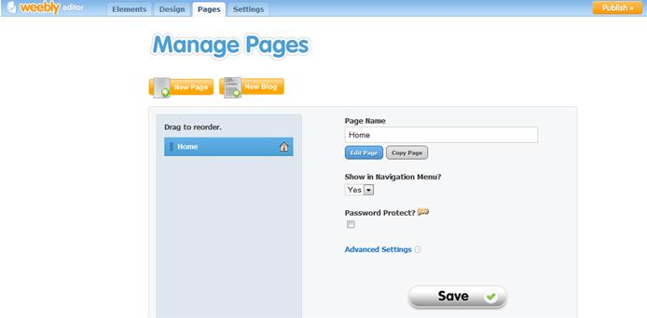
Creating Pages
Click to create a new blog
Click to create a new page
Edit Page settings

Slide 11
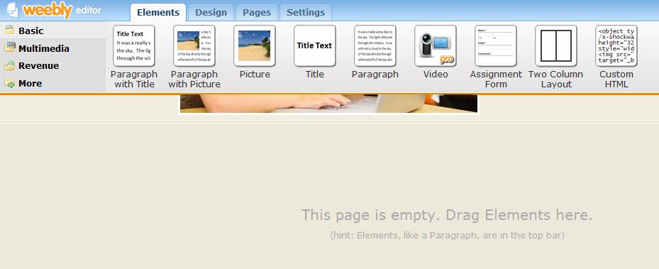
Building the page.
More elements listed under each tab.

Slide 12
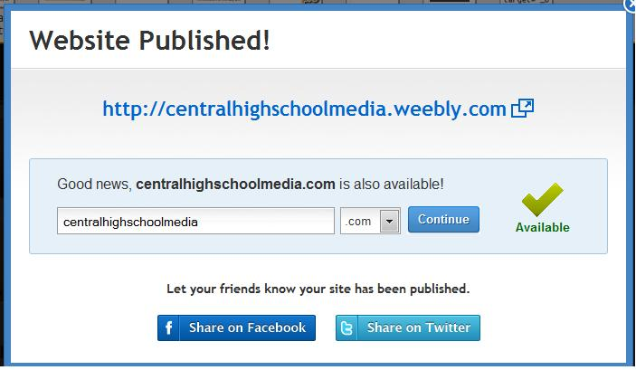
Publish
Click on the publish
button
You will be asked to choose your domain again.
Once the site is published you can share it on
Facebook or
Twitter.

Slide 13
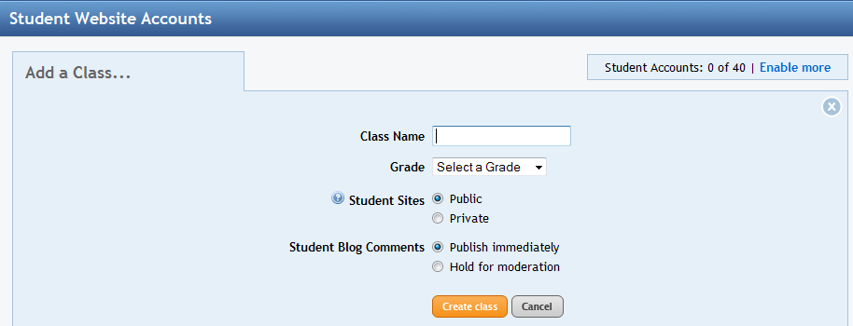
Student Webpages
Click here to begin
Click on
Create your class

Slide 14
Add students
Click on “Add a student”
Add up to 40 students
Students can use this to log on to students.weebly.com

Slide 15
What have you learned?
Before you leave please take some time to work with this technology and fill out the survey provided at the beginning of this presentation.
Completed surveys can be placed in the basket by the door.
Thank you!

